Slide 1
Exercise 1
Exercise #1
import pandas as pd
city_names = pd.Series(['San Francisco', 'San Jose', 'Sacramento'])
population = pd.Series([852469, 1015785, 485199])
cities = pd.DataFrame({ 'City name': city_names, 'Population': population })
cities['Area square miles'] = pd.Series([46.87, 176.53, 97.92])

Slide 2
Exercise 1
Exercise #1
Modify the cities table by adding a new boolean column that is True if and only if both of the following are True:
The city is named after a saint.
The city has an area greater than 50 square miles.
Note: Boolean Series are combined using the bitwise, rather than the traditional boolean, operators. For example, when performing logical and, use & instead of and.
Hint: "San" in Spanish means "saint."

Slide 3
Term Weights: Term Frequency
More frequent terms in a document are more important, i.e. more indicative of the topic.
f_{ij} = frequency of term i in document j
May want to normalize term frequency (tf) by dividing by the frequency of the most common term in the document:
tf_{ij} = f_{ij} / max_{i}{f_{ij}}

Slide 4
Term Weights: Inverse Document Frequency
Terms that appear in many different documents are less indicative of overall topic.
df _{i} = document frequency of term i
= number of documents containing term i
idf_{i} = inverse document frequency of term i,
= log₂ (N/ df _{i})
(N: total number of documents)
An indication of a term’s discrimination power.
Log used to dampen the effect relative to tf.

Slide 5
TF-IDF Weighting
A typical combined term importance indicator is tf-idf weighting:
w_{ij} = tf_{ij} idf_{i} = tf_{ij} log₂ (N/ df_{i})
A term occurring frequently in the document but rarely in the rest of the collection is given high weight.
Many other ways of determining term weights have been proposed.
Experimentally, tf-idf has been found to work well.

Slide 6
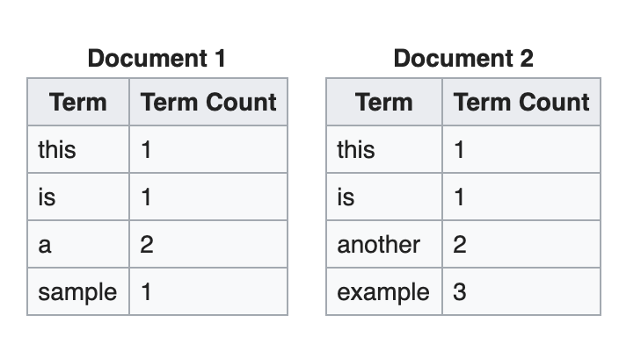
Exercise 2
Create 2 dataframes in pandas based on the information below and calculate tf-idf score for each word in document d1 and d2. The function you try to design is tfidf(w,d) where w can be any word in the vocabulary and d is either d1 and d2.

